Slide 1



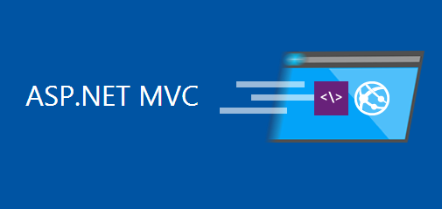
ASP.NET MVC
Web Applications with ASP.NET MVC, EF and SQL Server
ASP.NET
MVC
SoftUni Team
Technical Trainers
Software University
http://softuni.bg

Slide 2





Table of Contents
ASP.NET MVC Overview
Creating Controllers
Creating Views
Data-Driven Web Apps with MVC + Entity Framework
Creating Models with EF
CRUD Operations: View / Create / Edit / Delete Data

Slide 3
Have a Question?
sli.do #8358

Slide 4
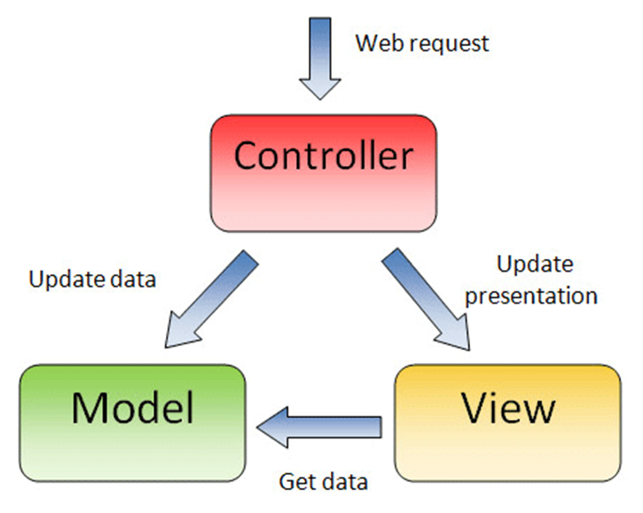
What is Model-View Controller (MVC)?
MVC == Model-View-Controller
Views (presentation / UI)
Render UI (produce HTML)
Controllers (logic)
Prepare UI (presentation logic)
Update database (business logic)
Models (data)
Data access classes or ORM

Slide 5
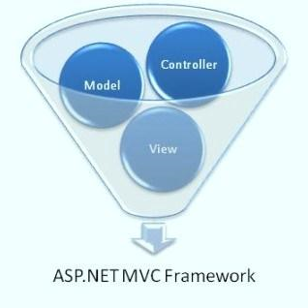

ASP.NET MVC – Overview
ASP.NET – modern Web development platform
Based on C# and .NET
Free, open-source
MVC (Web apps), Web API (Web services) and other components
ASP.NET MVC – powerful framework for modern Web apps
Model-View-Controller (MVC) based
Views, layouts, controllers, binding, validation, AJAX, REST, …

Slide 6



ASP.NET MVC: Setup IDE
Install Visual Studio 2015 (with the latest updates)
For VS 2013 install Update 5: https://www.visualstudio.com/...
For VS 2012 install the latest Web Tools: microsoft.com/download/details.aspx?id=41532

Slide 7
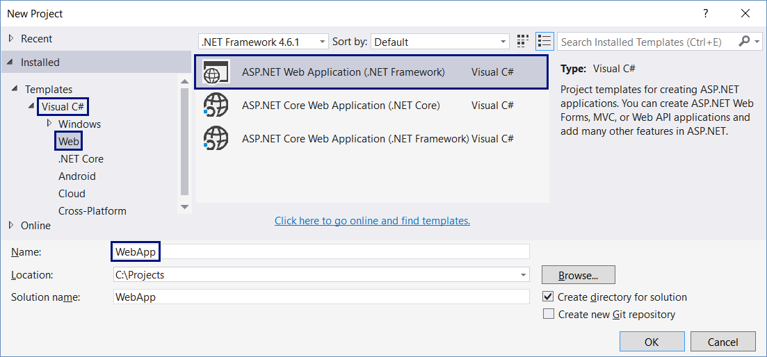
Create ASP.NET MVC App: Project Type

Slide 8
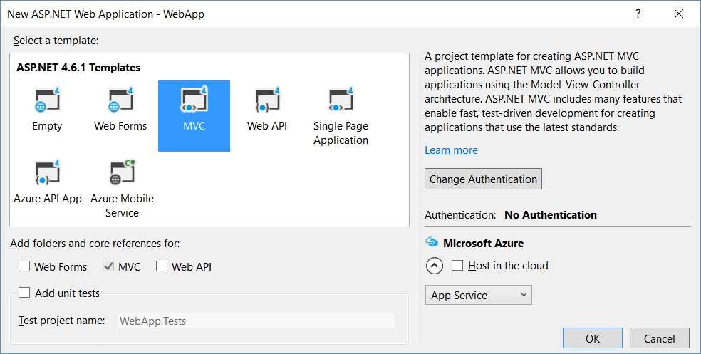
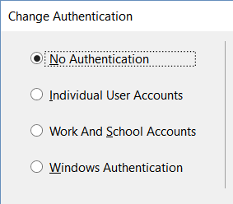
Create ASP.NET MVC App: Choose Template

Slide 9
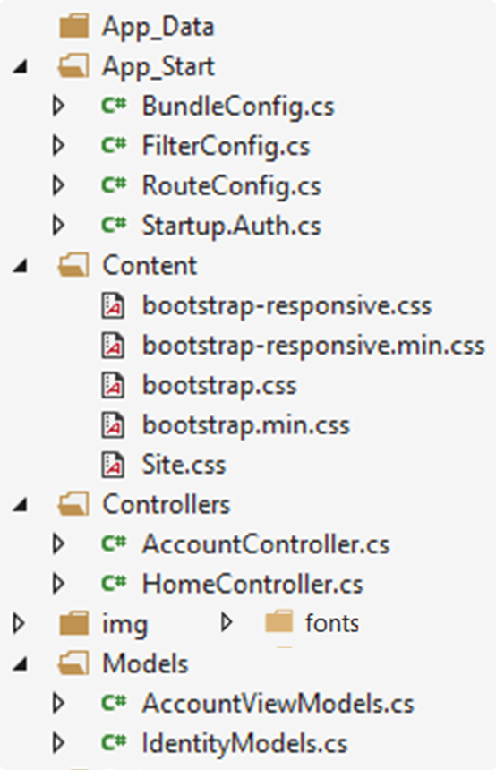
MVC App: What's Inside?
Loal DB files: holds the local SQL Server DB
Infrastructure classes, ASP.NET configuration
Controller classes holding actions
Static files: CSS styles
Models: EF classes + view models
Static files: images, fonts, …

Slide 10
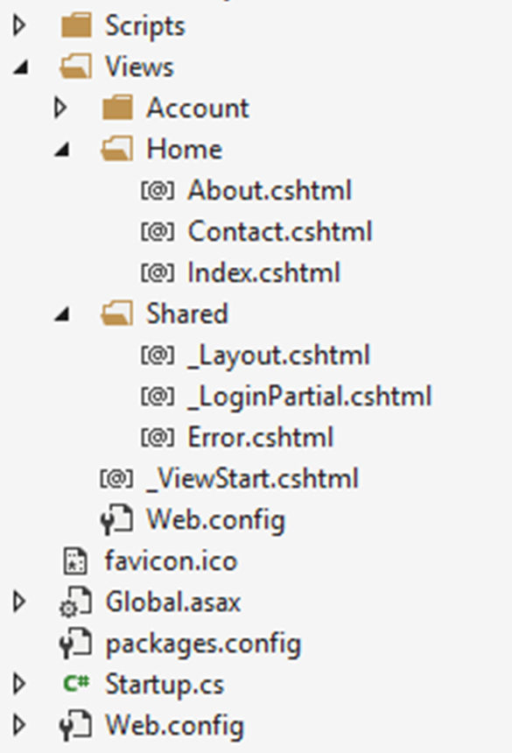
MVC App: What's Inside? (2)
Views: HTML templates for the pages
JavaScript code: jQuery, Bootstrap, custom JS code
Shared views: layout for all pages + partial views
View settings
App icon
App settings: holds the DB connection string
App start files
App start files
NuGet packages

Slide 11
Controllers
MVC controllers hold logic to process user actions
The URL /Home/About invokes HomeController → About()
\Controllers\HomeController.cs
public class HomeController : Controller
{
public ActionResult About()
{
ViewBag.Message = "Your application description page.";
return View();
}
}
Renders Views\Home\About.cshtml

Slide 12
Views
Views render the HTML code for the invoked action
ASP.NET MVC 5 uses Razor view engine
Views combine HTML with C# code
\Views\Home\About.cshtml
@{
ViewBag.Title = "About";
}
<h2>@ViewBag.Title</h2>
<h3>@ViewBag.Message</h3>
<p>Use this area to provide additional information.</p>
@ { … } inserts C# code block
@Something prints a C# variable
Everything else is HTML code

Slide 13
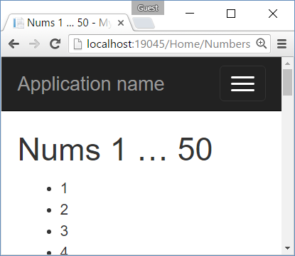
Example: Print the Numbers 1…50
Create an action /Home/Numbers + view Numbers.cshtml
HomeController.cs
\Views\Home\Numbers.cshtml
public class HomeController : Controller
{
public ActionResult Numbers()
{
return View();
}
}
@{ ViewBag.Title = "Nums 1 … 50"; }
<h2>@ViewBag.Title</h2>
<ul>
@for (int i = 1; i <= 50; i++)
{
<li>@i</li>
}
</ul>

Slide 14
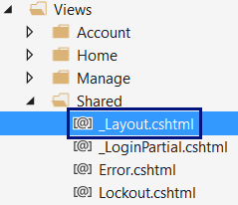
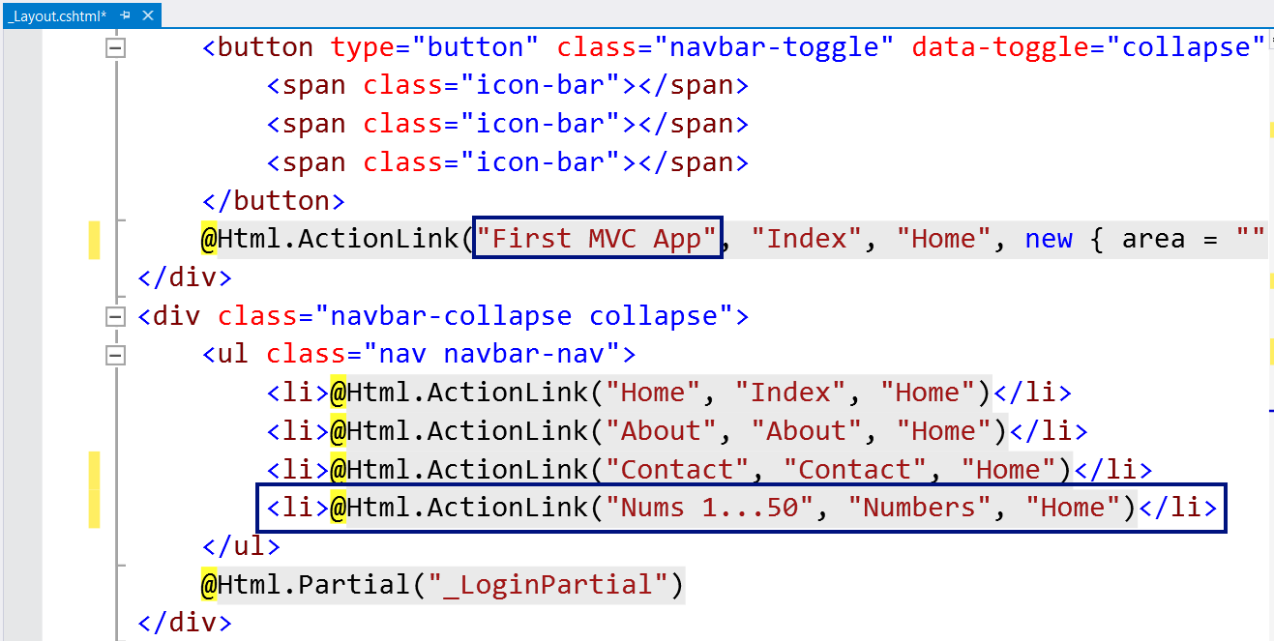
Changing the Page Layout

Slide 15
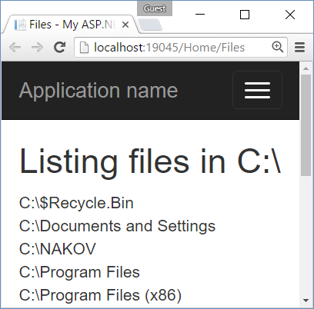
Example: List Files
Create an action Files to show the folders and files in C:\
HomeController.cs
\Views\Home\Files.cshtml
public ActionResult Files()
{
var path = @"C:\";
var files = Directory
.GetDirectories(path)
.ToList();
files.AddRange(
Directory.GetFiles(path));
return View(files);
}
@{ ViewBag.Title = "Files"; }
<h2>Listing files in C:\</h2>
@model List<string>
@foreach (var file in Model)
{
<div>
@file
</div>
}

Slide 16
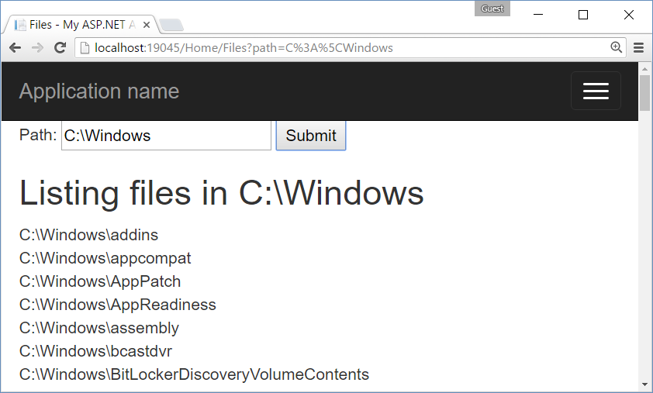
Example: List Files in Specified Folder

Slide 17
Solution: List Files in Specified Folder
HomeController.cs
\Views\Home\Files.cshtml
public ActionResult Files(
string path = @"C:\")
{
var files = Directory
.GetDirectories(path)
.ToList();
files.AddRange(Directory
.GetFiles(path));
ViewBag.Path = path;
return View(files);
}
@{ ViewBag.Title = "Files"; }
<form>
Path: <input type="text"
name="path" />
<input type="submit" />
</form>
<h2>Listing files in
@ViewBag.Path</h2>
@model List<string>
@foreach (var file in Model)
{ <div>@file</div> }

Slide 18
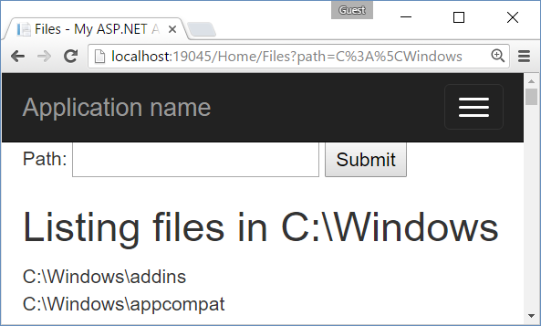
Creating Simple ASP.NET MVC App
Live Exercise in Class (Lab)

Slide 19
Data-Driven MVC Apps
Data-driven web applications
List data from database
CRUD operations over the data
ASP.NET MVC has great integration with Entity Framework
Visual Studio + MVC + EF
Great tools for rapid development of data-driven Web apps
Auto-generated views and controllers (scaffolding)

Slide 20
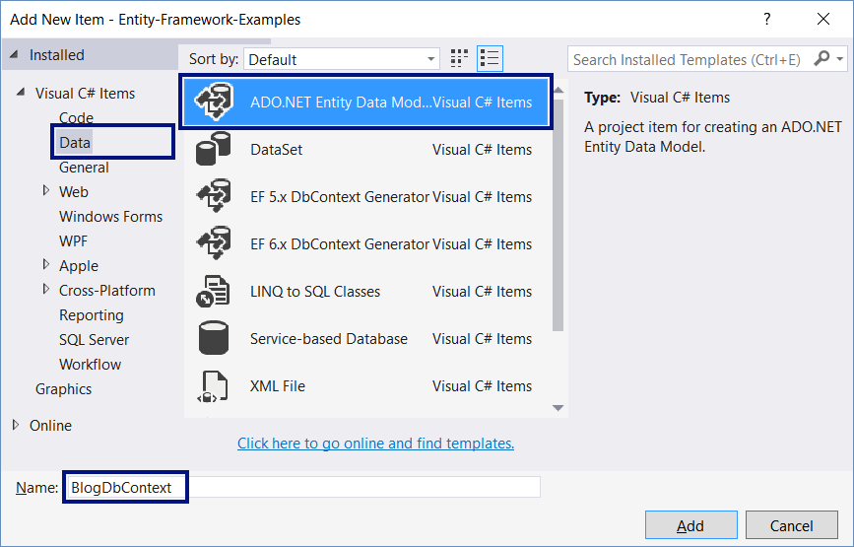
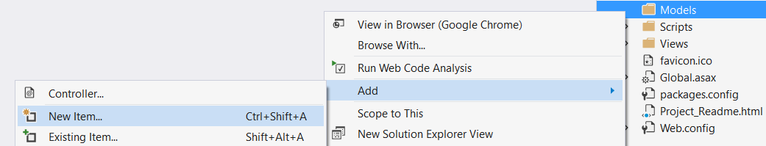
Defining Models with EF Code First

Slide 21
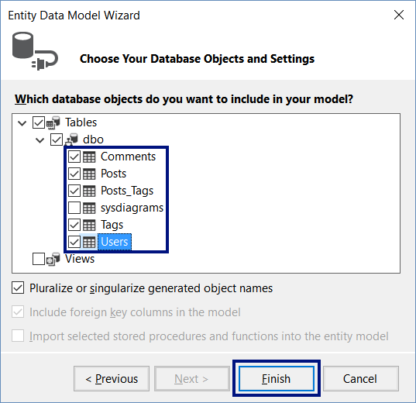
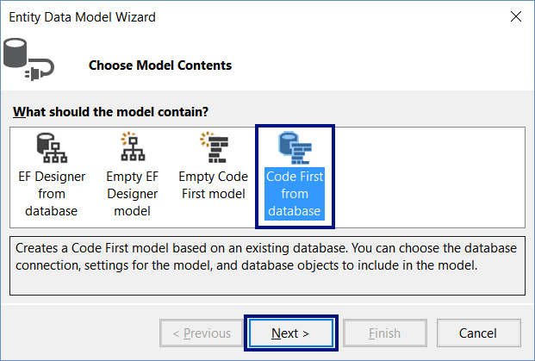
Defining Models with EF Code First (2)

Slide 22
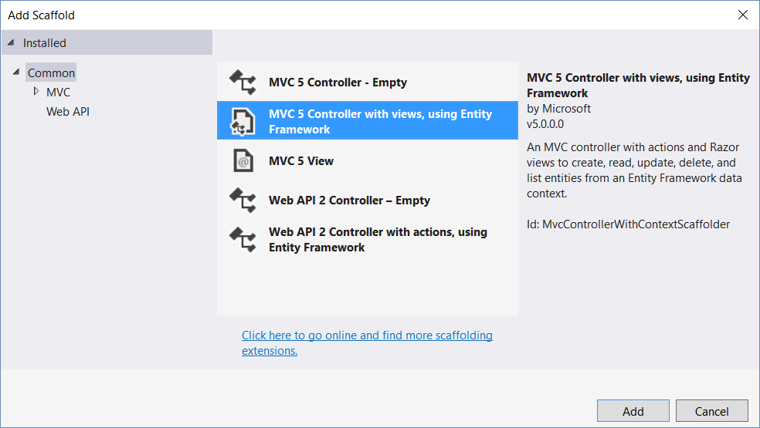
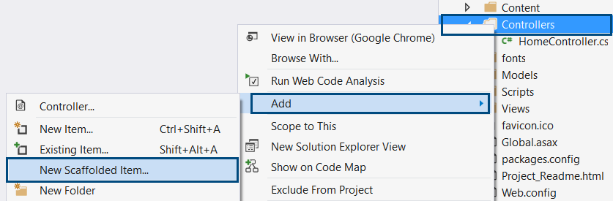
Implementing CRUD Operations

Slide 23
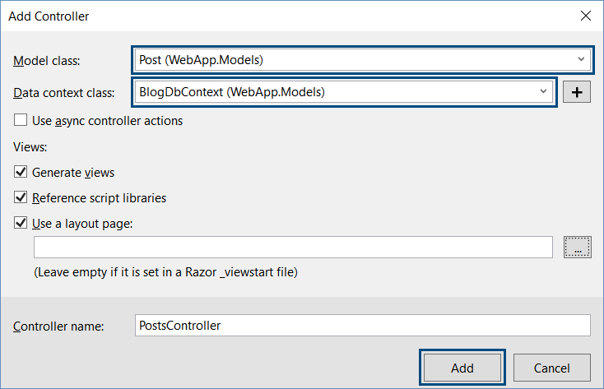
CRUD with MVC Scaffolding

Slide 24
List Items
PostsController.cs
\Views\Posts\Index.cshtml
// GET: Posts
public ActionResult Index()
{
var posts =
db.Posts.Include(
p => p.User);
return View(
posts.ToList());
}
<table class="table"><tr>
<th>@Html.DisplayNameFor(model =>
model.User.Username)</th>
…
</tr>
@foreach (var item in Model) {
<tr><td>
@Html.DisplayFor(modelItem =>
item.User.Username)</td>
… </tr>
}
</table>

Slide 25
Create / Edit / Delete / Details
PostsController.cs
\Views\Posts\Create.cshtml
public ActionResult Create() { … }
…
PostsController.cs
\Views\Posts\Edit.cshtml
public ActionResult Edit(…) { … }
…
PostsController.cs
\Views\Posts\Delete.cshtml
public ActionResult Delete(…) { … }
…
PostsController.cs
\Views\Posts\Details.cshtml
public ActionResult Details(…) { … }
…

Slide 26
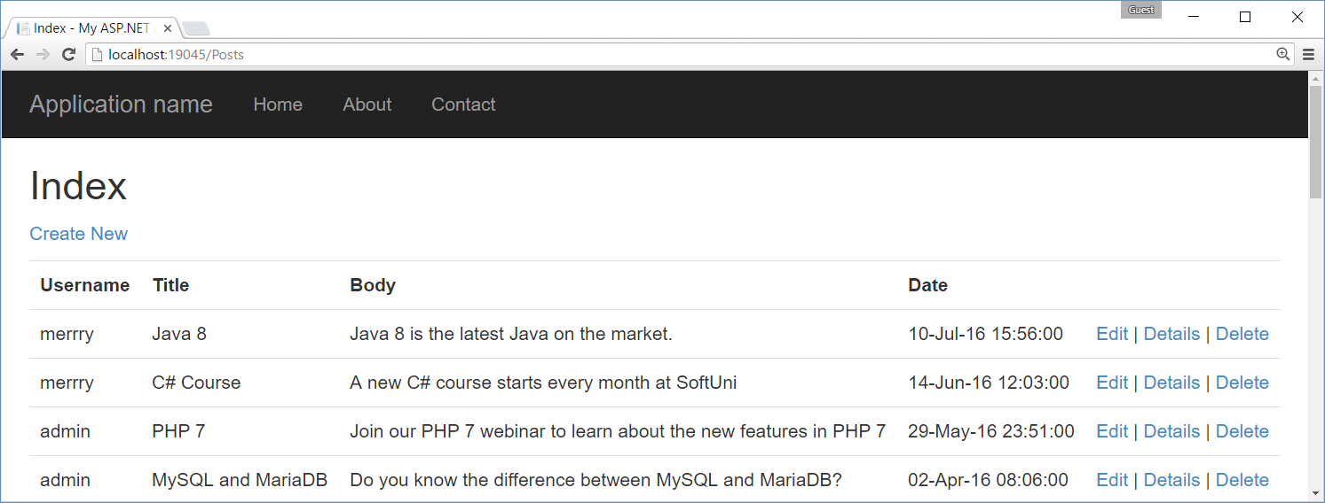
CRUD with MVC Scaffolding
Live Exercise in Class (Lab)

Slide 27


Summary
ASP.NET MVC is powerful Web development platform
Views render HTML code
Controllers process HTTP GET / POST actions
Great integration with databases and EF
VS generates CRUD operations by existing model
@foreach (var item in @Model)
{ <li>@item</li> }
public ActionResult Index()
{ return this.View(GetAllItems()); }

Slide 28








ASP.NET MVC
https://softuni.bg/courses/software-technologies

Slide 29
License
This course (slides, examples, demos, videos, homework, etc.) is licensed under the "Creative Commons Attribution-NonCommercial-ShareAlike 4.0 International" license

Slide 30






Free Trainings @ Software University
Software University Foundation – softuni.org
Software University – High-Quality Education, Profession and Job for Software Developers
softuni.bg
Software University @ Facebook
facebook.com/SoftwareUniversity
Software University @ YouTube
youtube.com/SoftwareUniversity
Software University Forums – forum.softuni.bg

